Slide 1
0
4
Virscend
University
Affordable. Accessible. WASC Accredited, STEM-Designated
16490 Bake Pkwy Suite 100 Irvine, CA 92618
+1 (949) 502-6252
admission@virscend.edu

Slide 2

Introduce Virscend University
01
TODAY’S TOPICS
02
Why do you need an MBA degree
03
Our Current Student Profile
Our Alumni Profile
04
05
Our MBA Program
Our Scholarships
06
The Comparison of other MBA programs
07
2

Slide 3

Mission
Inspire students with innovative ideas and business intelligence to prepare them to excel in a dynamic global environment.
3

Slide 4
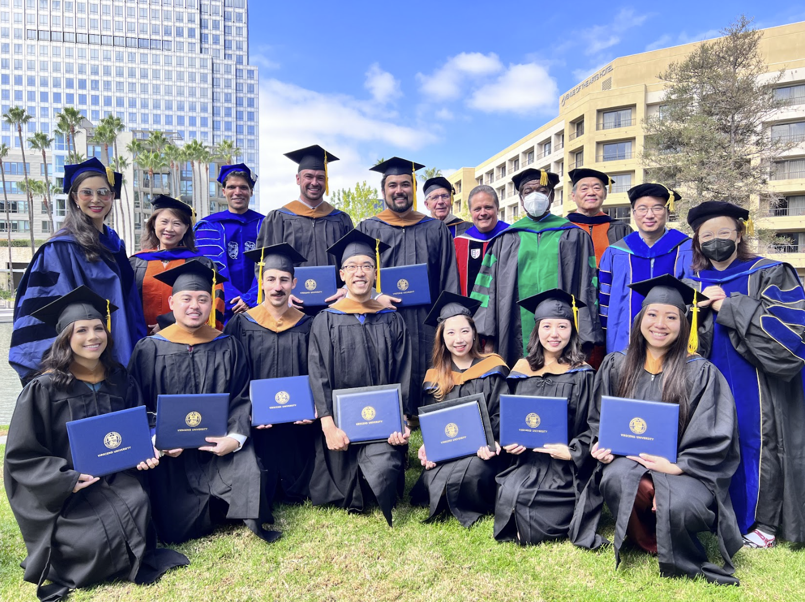
WASC Accreditation
Virscend University is accredited by the WASC Senior College and University Commission (WSCUC), 1080 Marina Village Parkway, Suite 500, Alameda, CA 94501, 510.748.9001.
The same accreditation for Stanford University, UC-Berkeley and UCLA.
More programs to come
  MS-Hospitality Tech Management
  MS-Business Intelligence
  DBA-Business Administration

Slide 5
Why Do You Need an MBA?
CONSIDER a Masters in Business Administration
Get a Master’s degree to increase your salary
Change your Career Path or get a better job
Learn more Management Skills
Start your own Business
5

Slide 6

Job Growth in Business Sector
“
Employment of management analysts is projected to grow 10 percent from 2022 to 2032, much faster than the average for all occupations.
About 92,900 openings for management analysts are projected each year, on average, over the decade.
“
Occupational Outlook Handbook
https://www.bls.gov/ooh/business-and-financial/management-analysts.htm
6
Notes:
https://www.bls.gov/ooh/business-and-financial/home.htm
Globalization, a growing economy, and a complex tax and regulatory environment are expected to continue to lead to strong demand for accountants and auditors. In addition, increasing usage of data and market research in order to understand customers and product demand, and to evaluate marketing strategies, will lead to growing demand for market research analysts.

Slide 7

Related Careers and Salary
Prepare for in demand jobs:
Computer and Information Systems Manager ($90,603 /year)
Information Security Analyst ($79,750 /year)
Operations Research Analyst ($85,403 /year)
Digital Marketing Specialist ($58,485 /year)
Finance Manager ($64,642 /year)
Marketing Research Analyst ($63,120 /year)
Product Manager ($64,387 /year)
Product Marketing Manager and Brand Manager ($64,241 /year)
Release Date: April 11, 2019
Information of average salary in Irvine ,CA from ZipRecruiter.
7

Slide 8
01
Convenient
Why
Choose
Virscend
University?
Affordable
02
Valuable
03
8

Slide 9
Convenient
01
  2 Year Full-Time Program
  10 courses
  Small Classes
  Convenient Location
  Hybrid Evening Courses 7:00 p.m.-9:45 p.m.
Why
Choose
Virscend
University?
Affordable
02
  Our program is 75% less than comparable programs
  $25,880 for the whole program (Tuition for 10 courses and registration for 4 semesters)
Valuable
  STEM-Designated
  Can issue form I-20 for international students
  Quality teaching: all instructors are either from CSU/UC and/or industry professionals
  Plenty of 1:1 interactions between students and professors
  Updated Curriculum
03
9
Notes:
Instead of Updated Curriculum changed to The curriculum is relevant to market needs.

Slide 10
Convenient
01
  2 Year Full-Time Program
  10 courses
  Small Classes
  Convenient Location
  Hybrid Evening Courses 7:00 p.m.-9:45 p.m.
Affordable
Why
Choose
Virscend
University?
02
  Our program is 75% less than comparable programs
  $25,880 for the whole program (Tuition for 10 courses and registration for 4 semesters)
Valuable
  STEM-Designated
  Can issue form I-20 for international students
  Quality teaching: all instructors are either from CSU/UC and/or industry professionals
  Plenty of 1:1 interactions between students and professors
  Updated Curriculum
03
10
Notes:
Not saved.

Slide 11
Convenient
  2 Year Full-Time Program
  10 courses
  Small Classes
  Convenient Location
  Hybrid Evening Courses 7:00 p.m.-9:45 p.m.
01
Affordability
Why
Choose
Virscend
University?
  Our program is 75% less than comparable programs
  $25,880 for the whole program (Tuition for 10 courses and registration for 4 semesters)
02
Valuable
  STEM-Designated
  Can issue form I-20 for international students
  Quality teaching: all instructors are either from
  CSU/UC and/or industry professionals
  Plenty of 1:1 interactions between students and
  professors
  Updated Curriculum
03
11

Slide 12
Our Program
Virscend University’s MBA STEM-designated program consists of the following 10 courses and can be completed in 2 years as a full-time student
Financial Management
Accounting Management
Management Information Systems
Decision Technologies and Statistics
Marketing Management
Digital Marketing
Add Contents Title
Database Management
Data Analytics
Management Strategies
Project Management
12

Slide 13
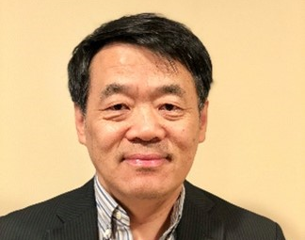
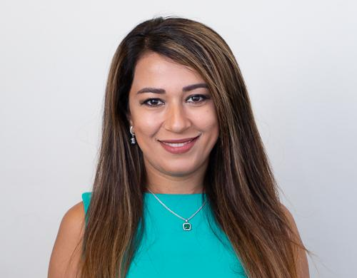
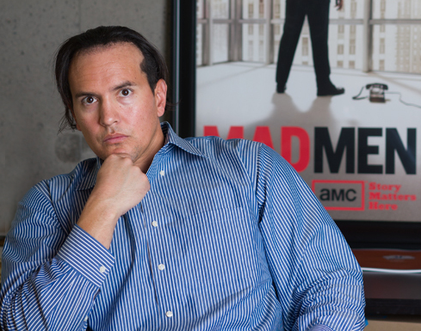
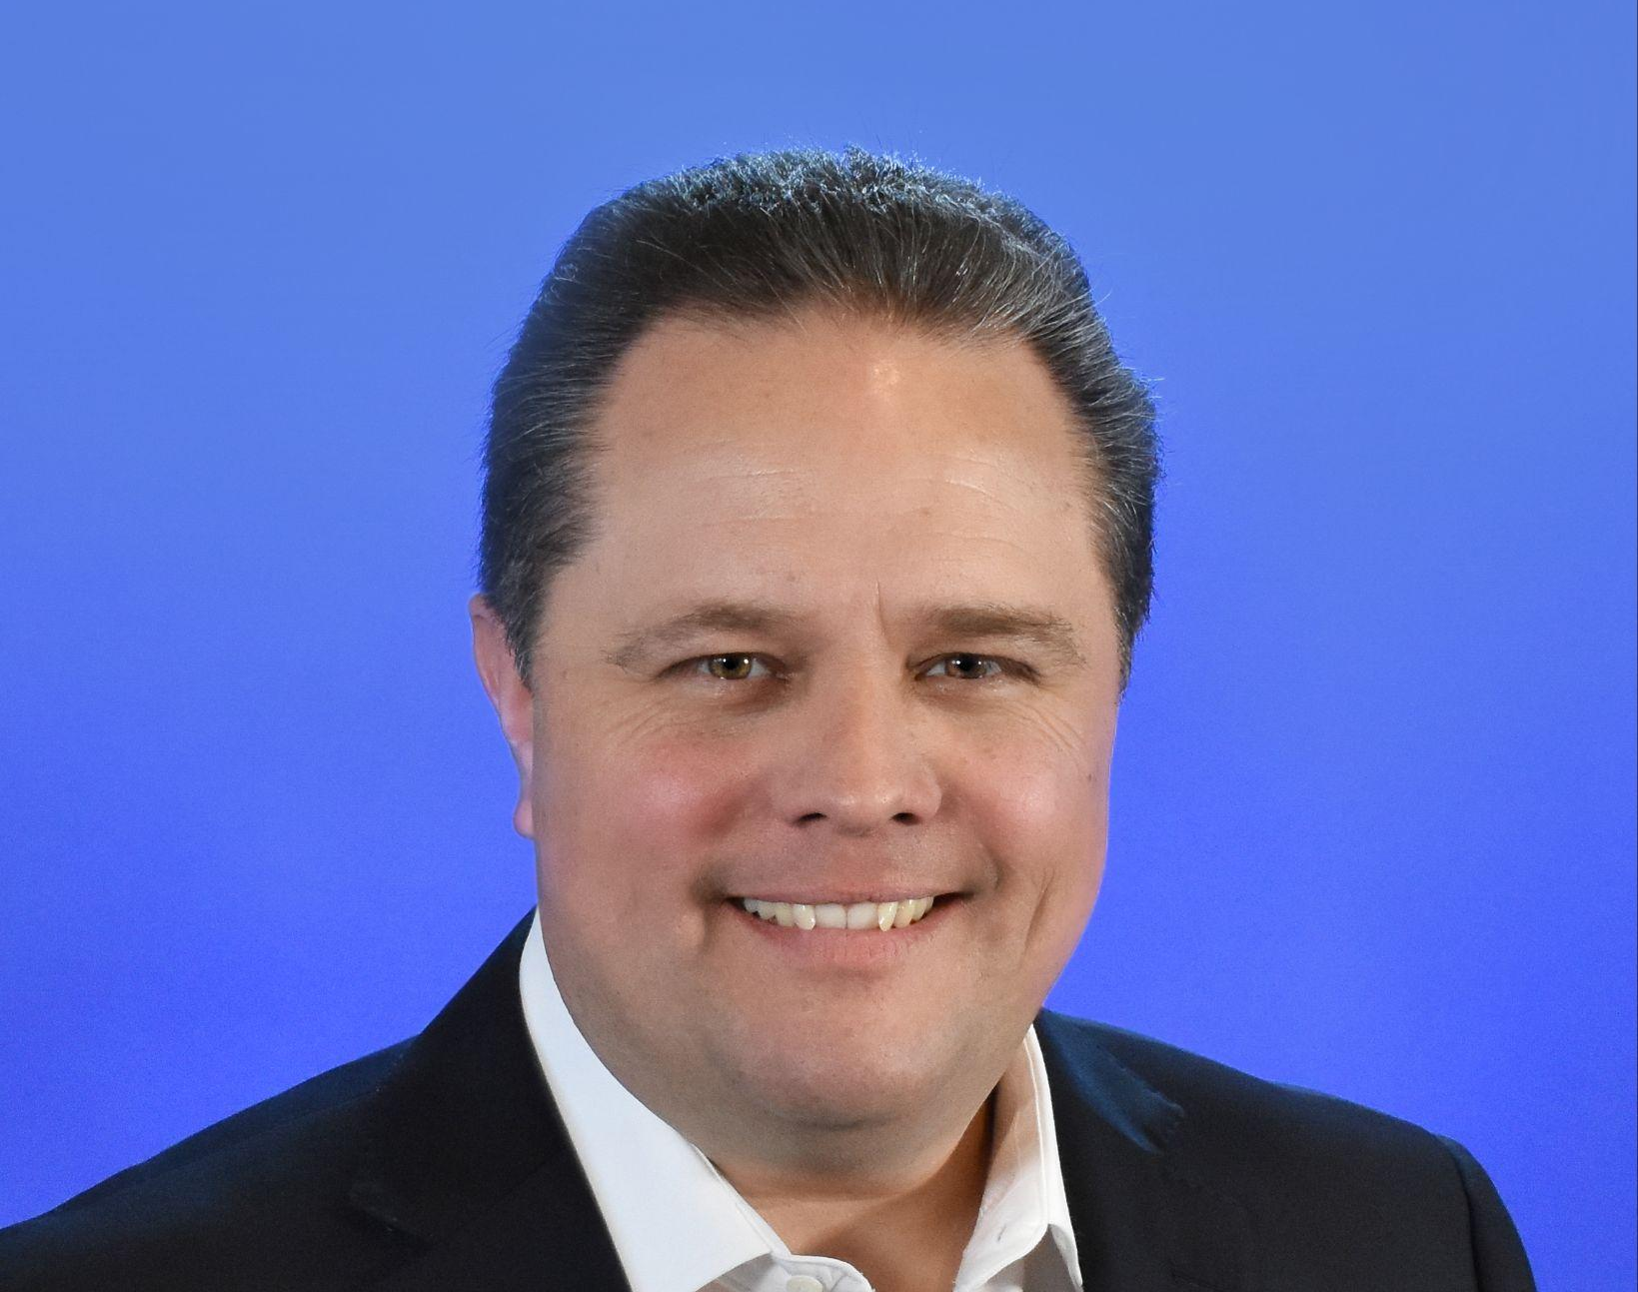
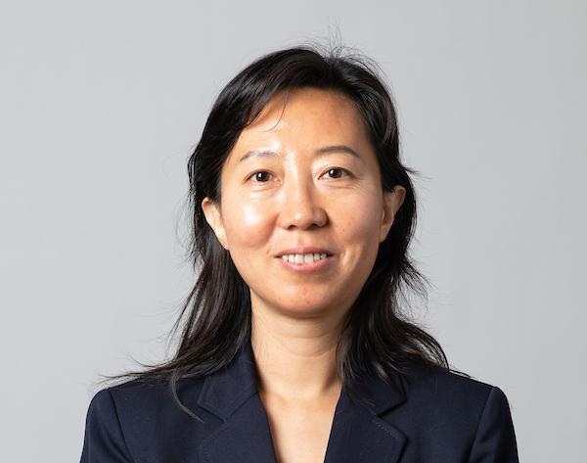
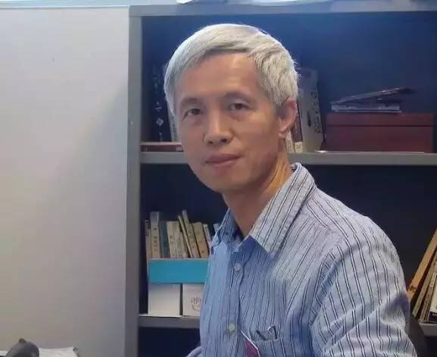
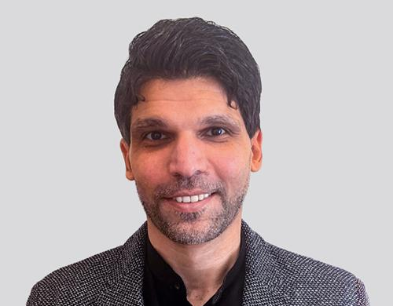
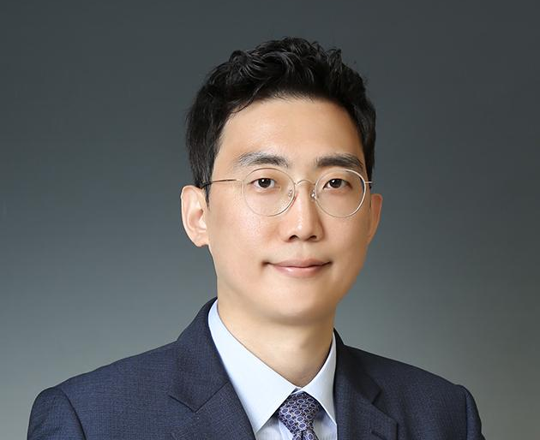
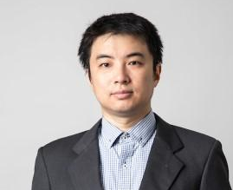
Our Faculty
Virscend University has a diverse faculty who come from diverse backgrounds and also teach at nearby CSU and UC schools
Dr.Robert Chi
University of Texas at Austin
Ph.D. in Information Systems
Courses Taught:
MBA 500 & MBA 650
Dr.Banafsheh Behzad
University of Illinois at Urbana-Champaign
Ph.D. in Industrial Engineering
Course Taught:
MBA 501
Professor Christopher Medina
Azusa Pacific University
MBA
Course Taught:
MBA 621
Dr.Sean Jasso
Claremont Graduate University
Ph.D. in Political Economy
Courses Taught:
MBA 502 & MBA 505
Dr.Ping Lin
UC Irvine
Ph.D. in Accounting
Course Taught:
MBA 504
Dr.Minder Chen
University of Arizona
Ph.D. in Management Information Systems
Courses Taught:
MBA 500 & MBA 650
Dr.Mohamed Abdelhamid
University at Buffalo
Ph.D. in Management Science and Systems
Course Taught:
MBA 520
Dr.Hojong Shin
Michigan State University
Ph.D. in Finance
Course Taught:
MBA 503
Dr. Jianqing "Fisher" Wu
Purdue University
Ph.D. in Management Science and Systems
Course Taught:
MBA 601
13

Slide 14

Application
Requirements
Resume
Copy of Passport
Personal Essay (Link to Questions Here)
Official/Unofficial Transcripts
If your GPA is below 2.5, you will also need to submit an academic personal statement​
​Language Test Scores
Minimum of 80 TOEFL, 6.0 IELTS, 58 PTE, 115 DUOLINGO, 1 EIKEN, 169 Cambridge English Assessment, 690 TOEIC or Level 6 of an ESL program
  We accept scores from all language exams, submit your score and we can assess accordingly
  If you cannot meet the minimum language score, you can still apply, but an additional interview with our admissions team will be required
Degree Verification (wes.org, ierf.org, naces.org, or apie.org)
Bank Confirmation Letter
Simple Portfolio Presentation

Slide 15
The Comparison of other MBA Programs
Schools | Tuition | Time to graduate | Faculty with PhD
UCLA | 120,000 | 1.5-3 years | 100%
USC | 140,000 | 1-2 years | 100%
UCR | 100,000 | 1.5 years | 90%
CSULB | 60,000 | 2 years | 85%
CSUF | 60,000 | 2 years | 85%
Chapman | 80,000 | 2 years | 80%
Virscend | 24,000 | 2 years | 90%
15

Slide 16
How to Apply for Admission
Call us at +1(949) 502-6252 or send an email to admission@virscend.edu to chat with a counselor and learn about how you can benefit from our MBA program!
D
C
B
Submit application!
Complete application & Gather Documents
A
Click on Graduate
Program
Click on Apply Now!
Step D
Visit
www.virscend.edu
Step C
Step B
Step A
16

Slide 17

17

